Slide 1

British Airways Reviews

Slide 2
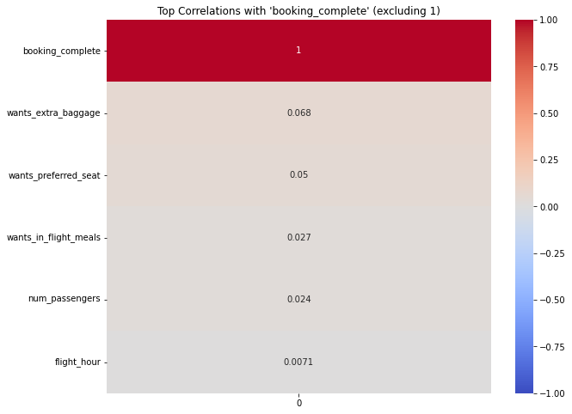
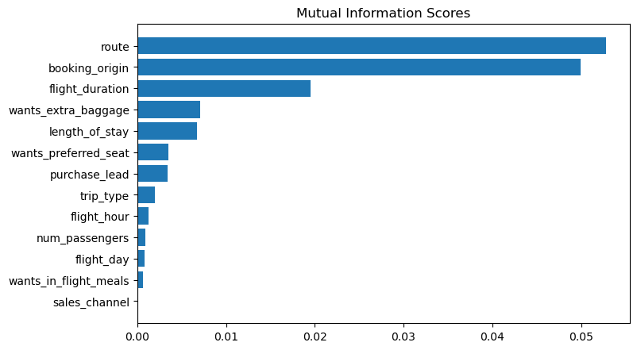
predictive model to understand factors that influence buying behaviour
We have trained the data set with Random forest classifier model and received
ACCURACY: 83.36
AUC score: 0.565
route
booking_origin
flight_duration
wants_extra_baggage
length_of_stay
are the top 5 features which influence
Customer buying behavior
We should increase the AUC score.

